Slide 1
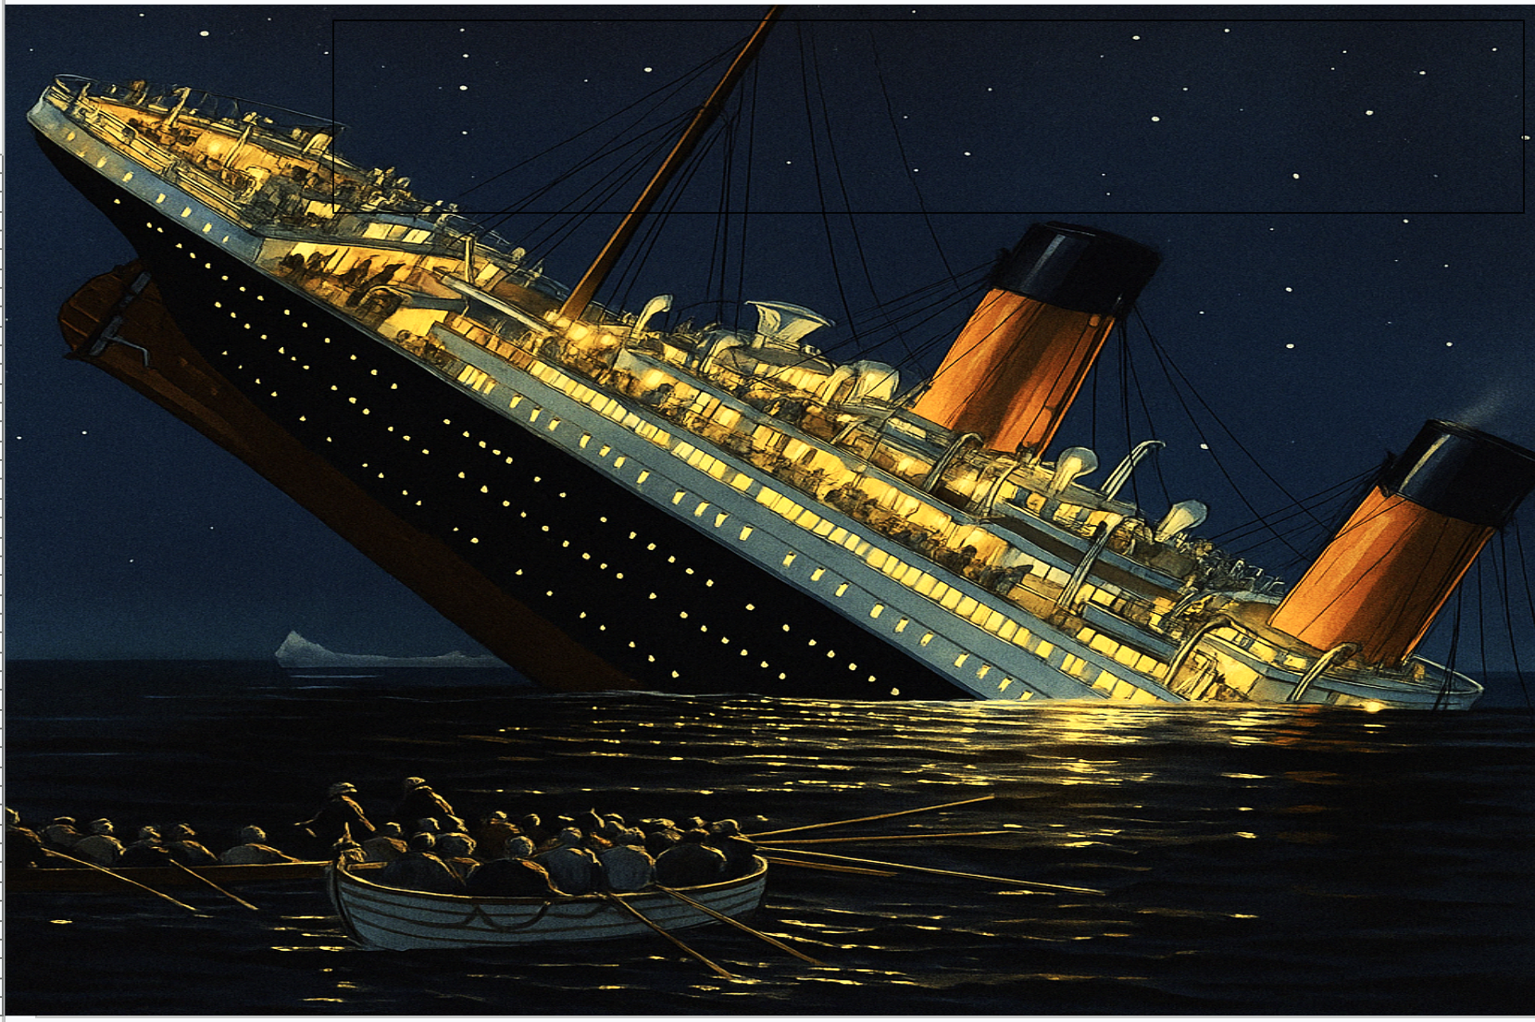
LSC 563: Data Visualization Final Project
Socioeconomic Disparities in Survival During the Titanic Disaster:
A Data Visualization Study
Ibrahima Medina Aaquil

Slide 2
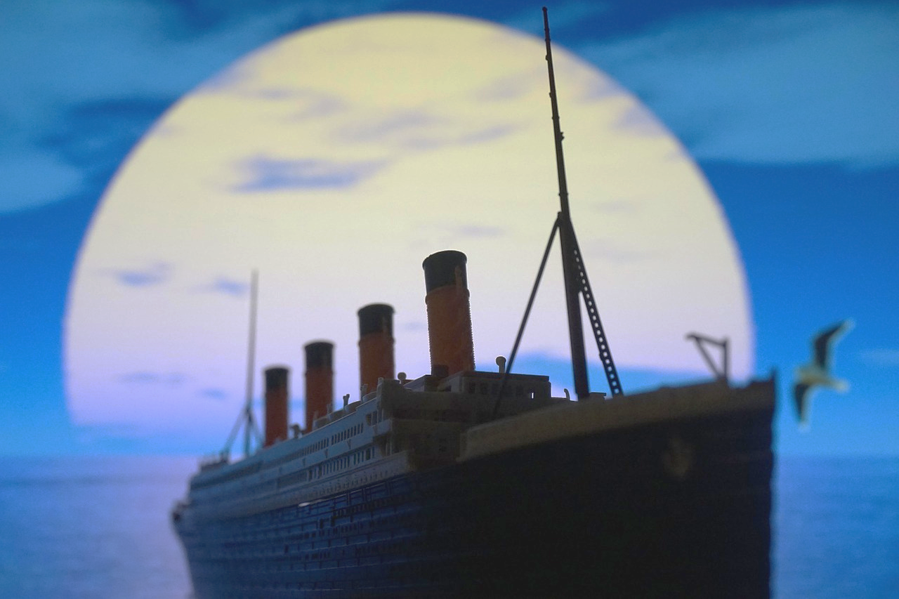
Introduction
The sinking of the Titanic in 1912 remains one of the most well-known maritime disasters in history.
Survival was not random; patterns emerged based on gender, class, age, and economic status.
This project analyzes survival patterns using data visualization techniques in R.
Central Research Question: How did socioeconomic status, gender, age, and ticket fare influence survival rates aboard the Titanic?
This study bridges historical context and modern data analytics to explore the human impact of inequality during crisis.

Slide 3
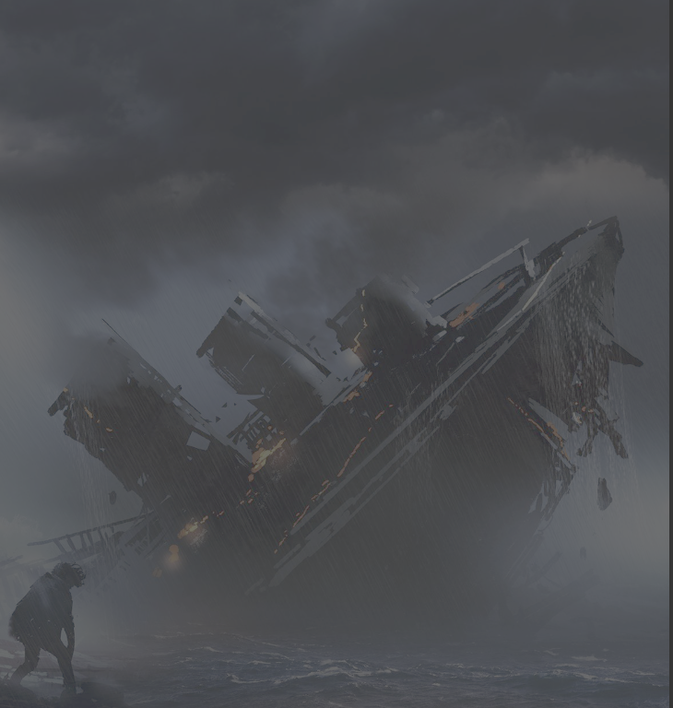
Dataset & Tools
Tool Used:
Why this dataset?
Dataset:
Titanic Dataset from the Awesome Public Datasets GitHub Repository (891 passengers, includes survival status, class, gender, age, fare, embarkation)
RStudio (with tidyverse, readr, ggplot2, ggridges, viridis, forcats)
Rich historical relevance
Offers structured, individual-level data
Enables clear visualizations of class and gender disparity in survival

Slide 4
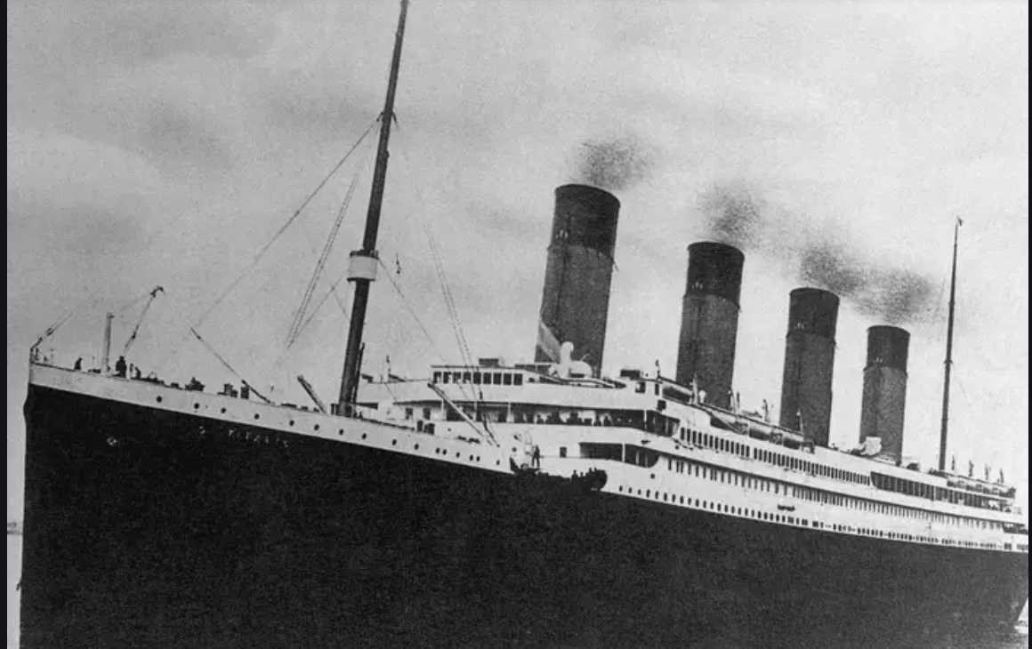
Analysis Overview
🔧 Data Cleaning & Prep
📊 Summary Statistics
🔍 Exploratory Analysis
Survival rates by:
Renamed columns for consistency
Calculated fare averages by class & gender
Class
Recoded Survived as
"Yes" / "No"
Counted survival outcomes by gender & fare quartiles
Gender
Created AgeGroup with cut()
Age Group
Selected key variables: Sex, Class, Fare, age, Survived, Embarked.
Embarkation Port
Fare Quartiles
(Socioeconomic Status)

Slide 5
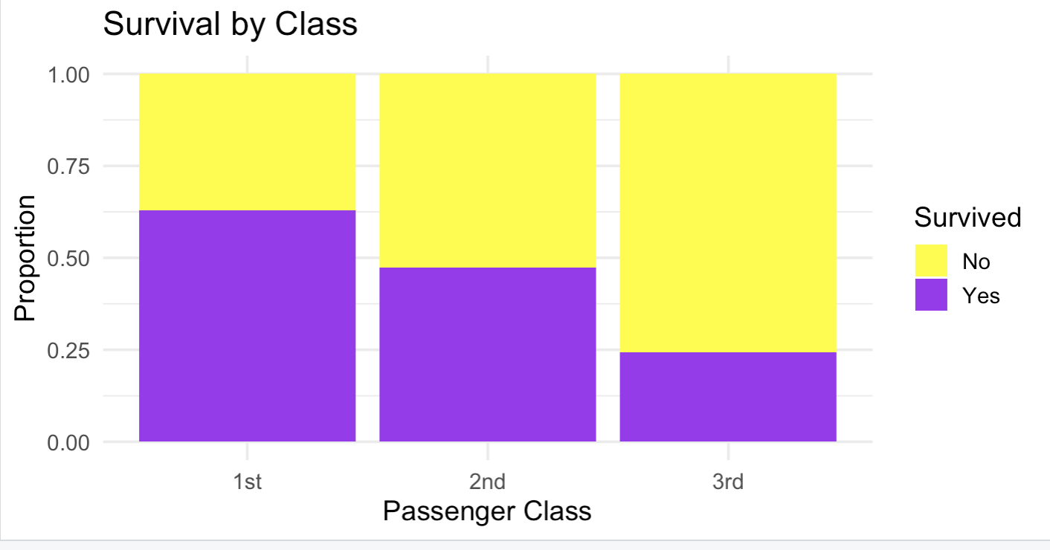

Slide 6
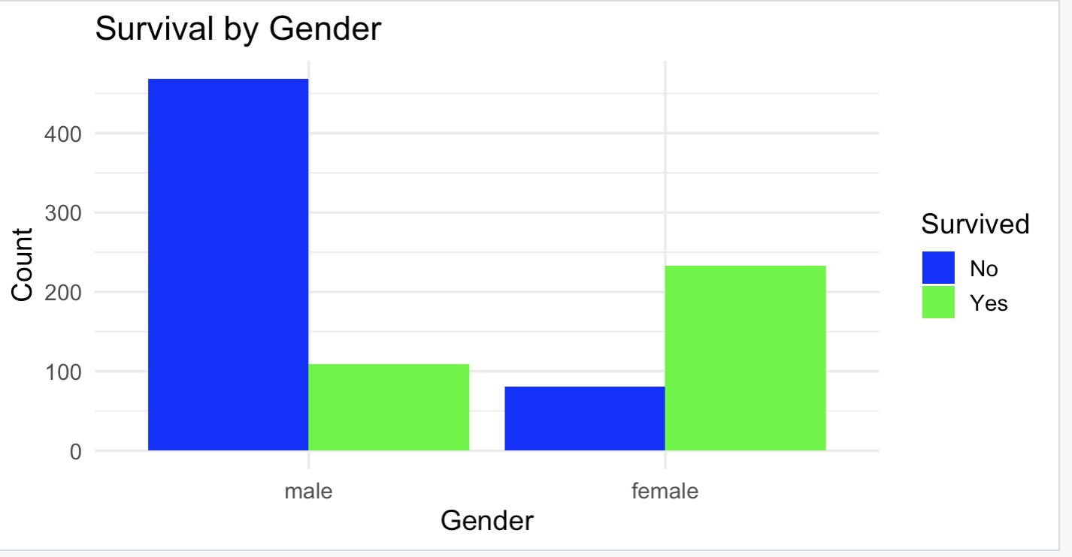

Slide 7
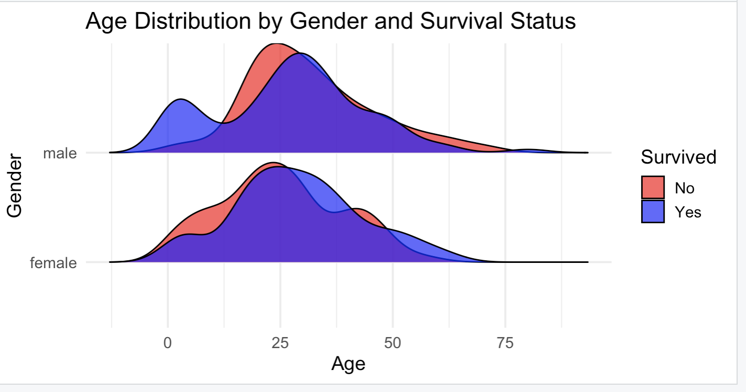

Slide 8
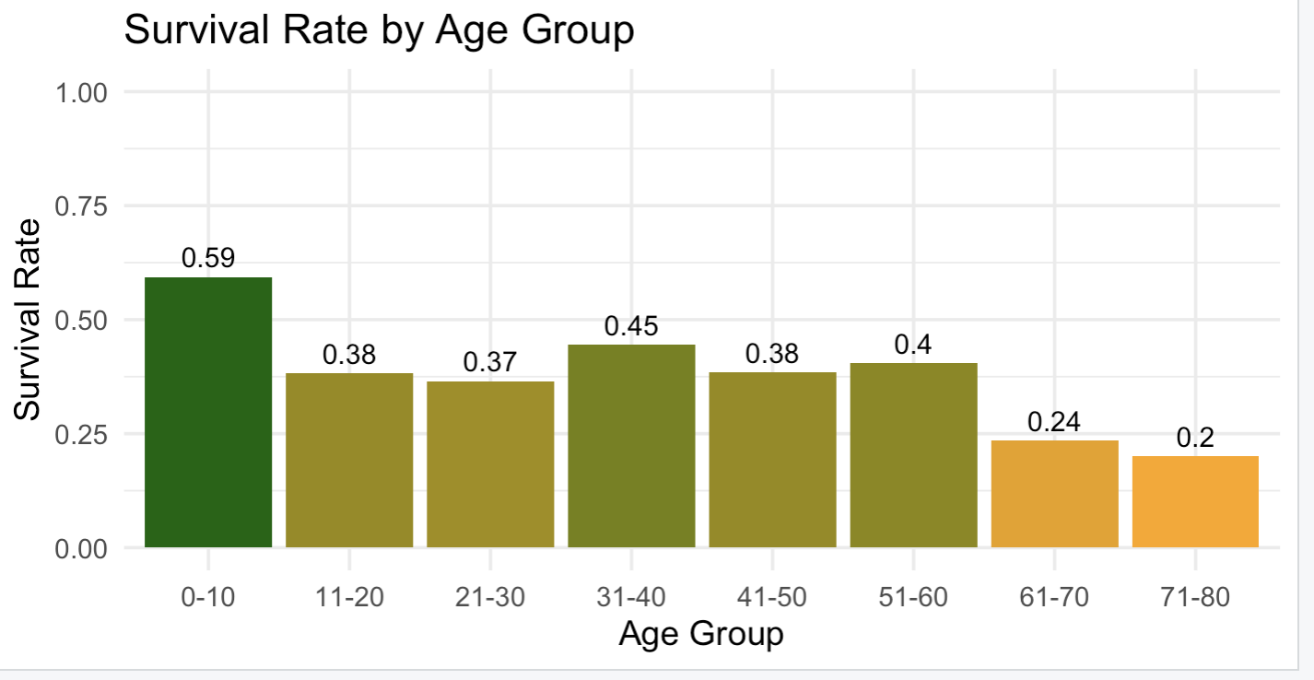

Slide 9
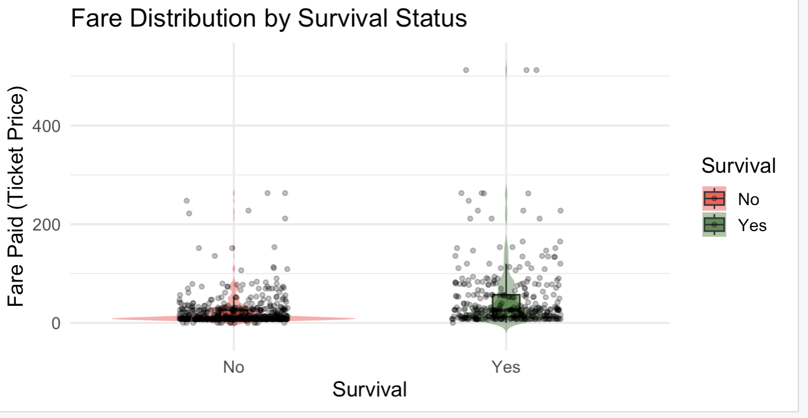

Slide 10
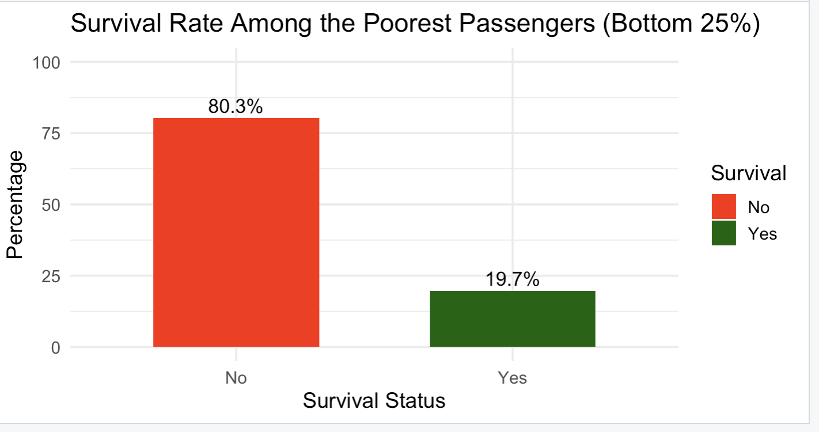

Slide 11
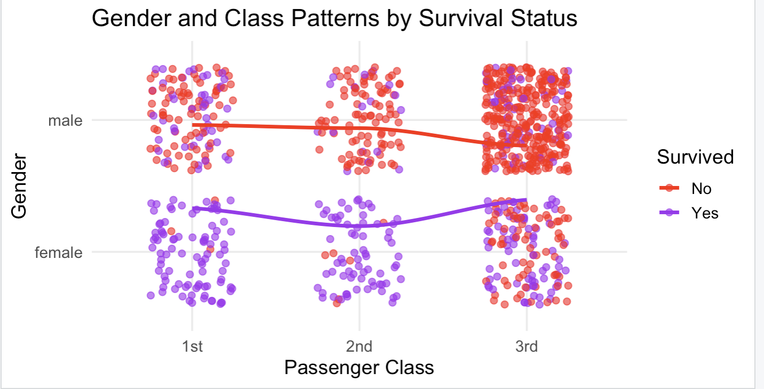

Slide 12
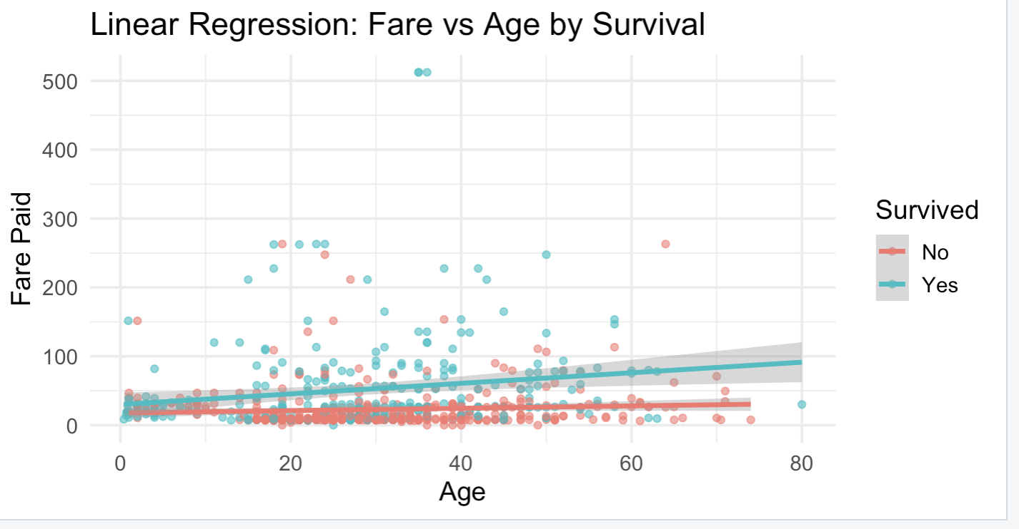

Slide 13
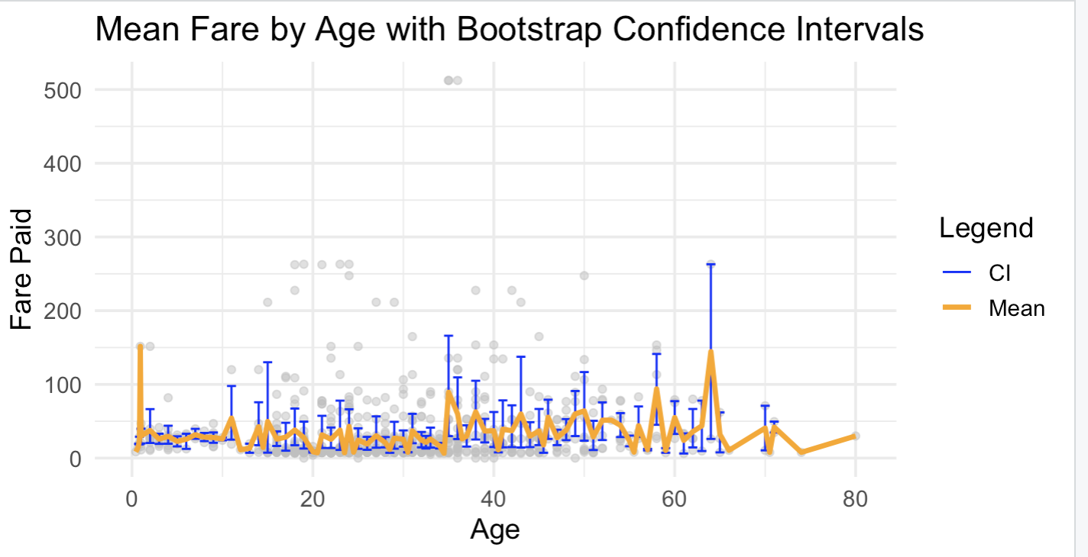

Slide 14
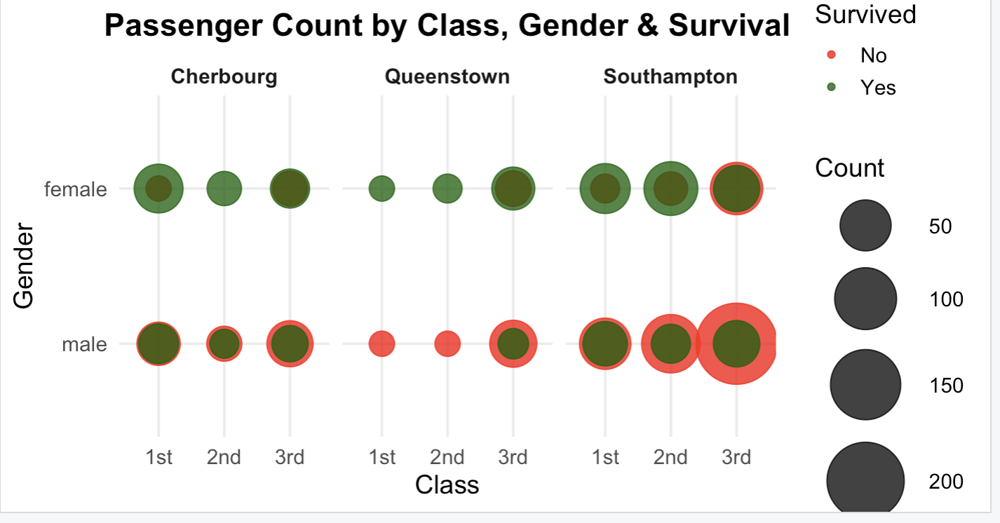

Slide 15
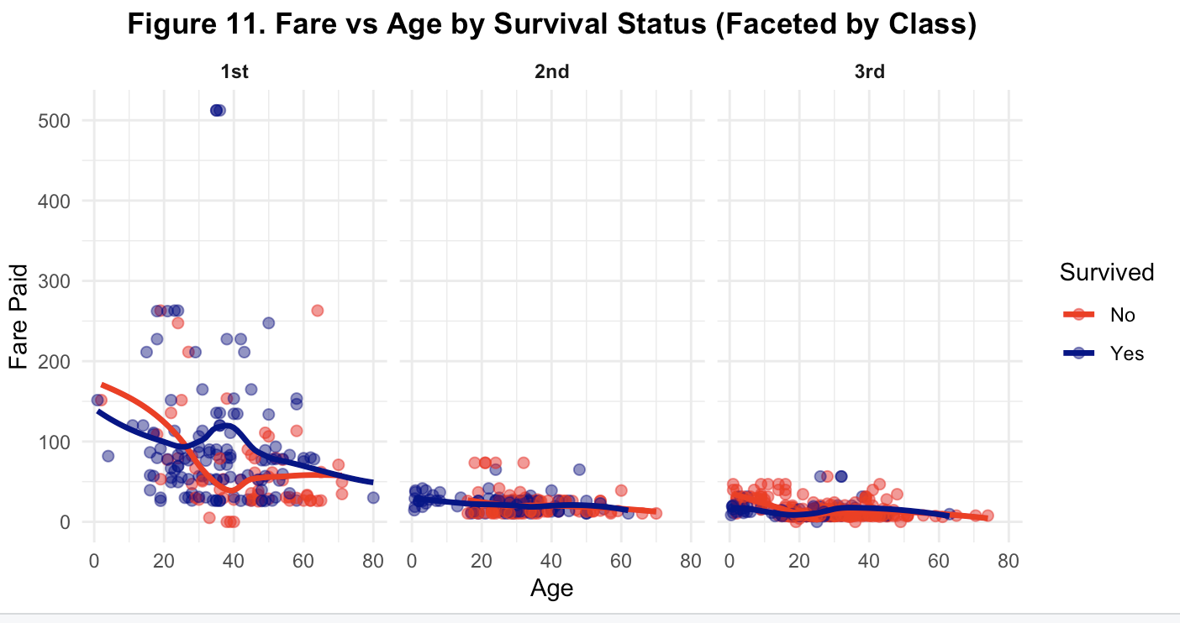

Slide 16
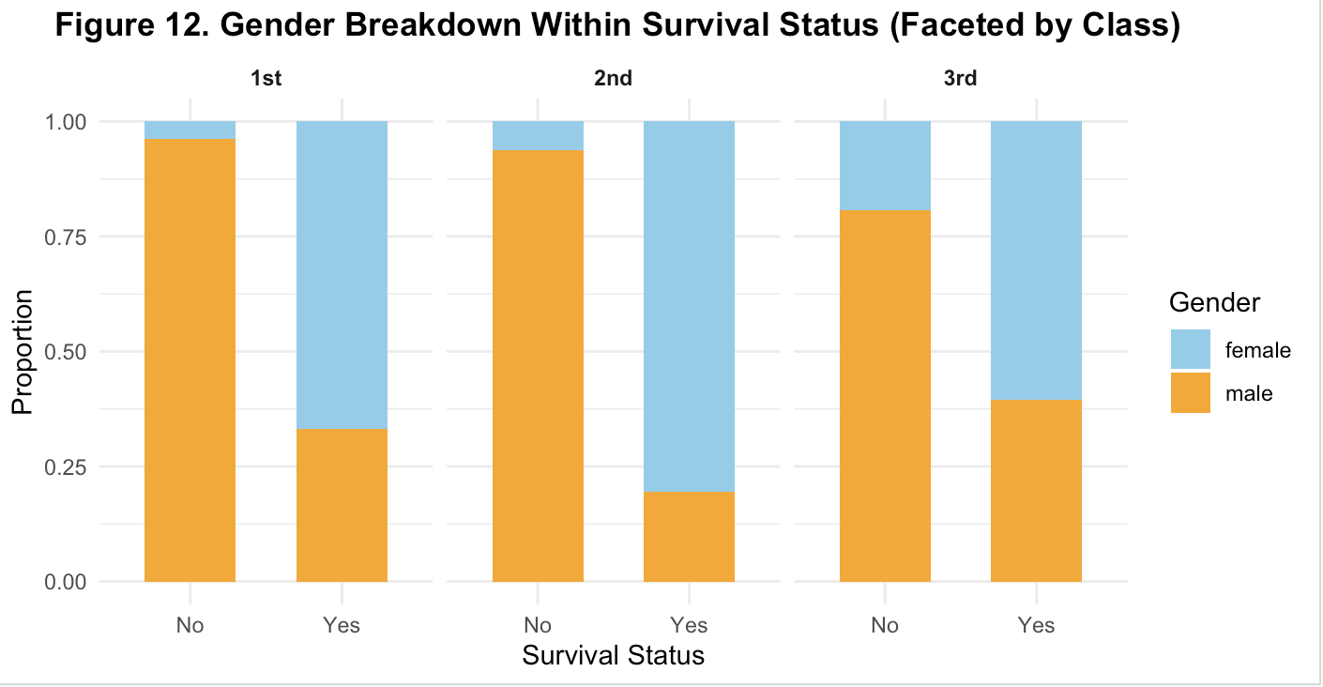

Slide 17
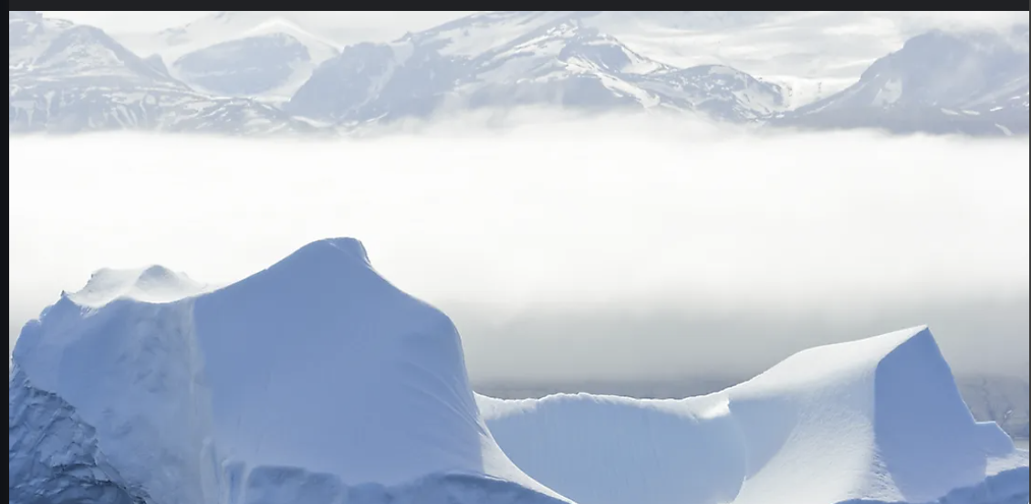
Challenges Faced During Analysis & Visualization
🧹 Data Cleaning
▸ Had to rename inconsistent column names for easier use in R
▸ Some missing or NA values in age and fare required filtering
📊 Plotting Issues
▸ Overlaying multiple plot types (e.g., violin + box + jitter) took trial and error
▸ LOESS & regression plots needed scale adjustments for clarity
🎯 Analytical Decisions
▸ Deciding how to define "poorest" passengers (used bottom 25% fare)
▸ Faceting and axis adjustments were needed to avoid misleading visuals

Slide 18
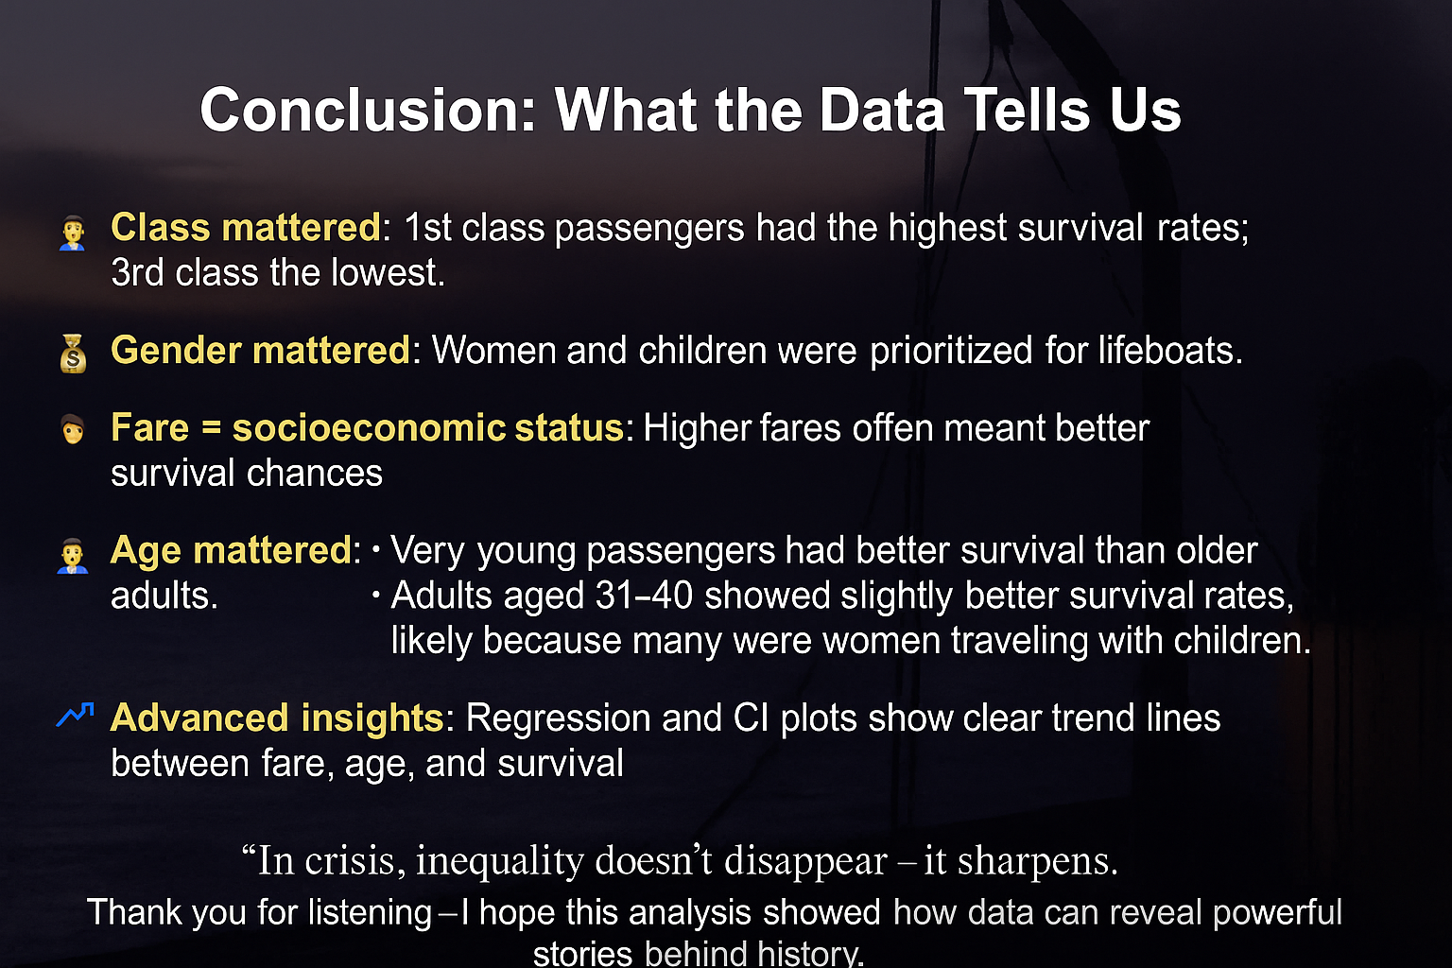

Slide 19
📸 Image Sources
• Current Affairs. (2021, October). How the Titanic haunts us. Retrieved from https://www.currentaffairs.org/news/2021/10/how-the-titanic-haunts-us
• AP News. (n.d.). A new Titanic expedition is planned. The US is fighting it, says wreck is a grave site. Retrieved from https://apnews.com/article/titanic-expedition-rmst-marconi-radio-ce027ac27d8f4804304b5f33fa471dda
• iCorridor. (2018, November 23). The Titanic II will retrace the journey of the famous ship in 2022 [Photograph]. Retrieved from https://icorridor.org/2018/11/23/the-titanic-ii-will-retrace-the-journey-of-the-famous-ship-in-2022/
• Beyond Penguins and Polar Bears – The Ohio State University. (n.d.). All About Icebergs. Retrieved from https://beyondpenguins.ehe.osu.edu/issue/icebergs-and-glaciers/all-about-icebergs

